Slide 1
P1: Browser Graphics
Due 10/11/2017

Slide 2
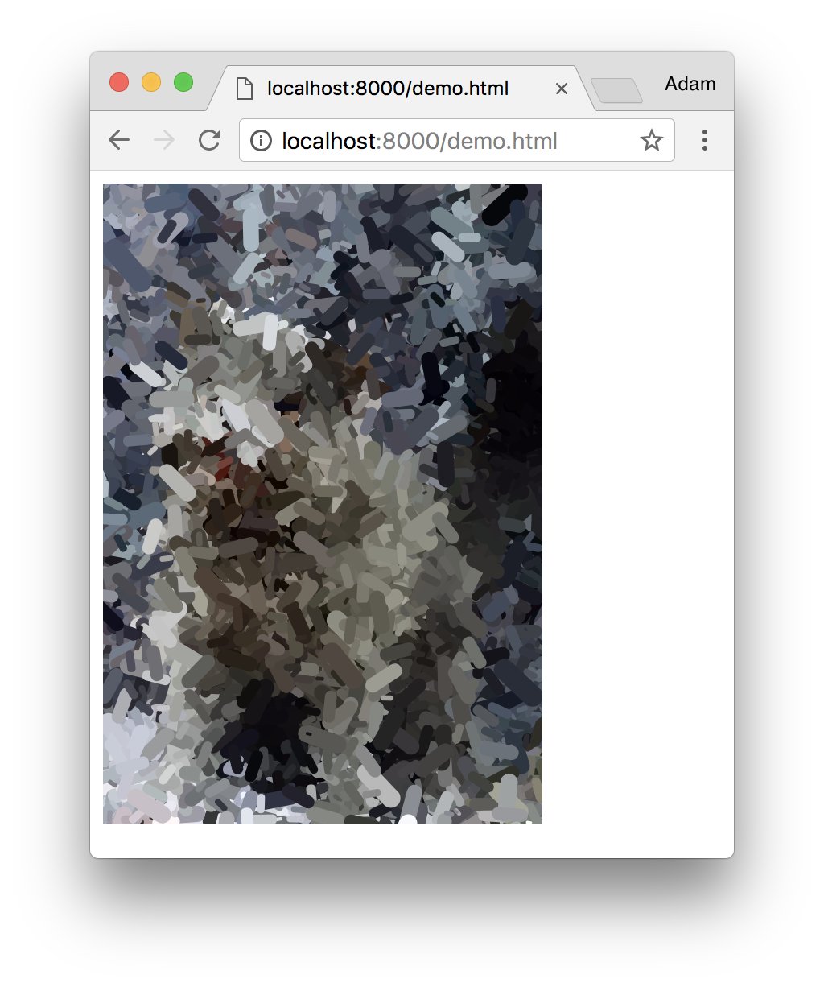
Overview
In this programming assignment, you’ll create a program that generativity and interactively reinterprets an image of your own selection.
Practice goals:
Start a local web server
Edit and debug JavaScript in the Chrome browser’s development tools
Use P5js to read from and draw on images
Start thinking about generativity

Slide 3
Starting a local web server
Make sure your machine has Python installed (preferably Python 3).
In the command line, run:
Python2
python -m SimpleHTTPServer
Python3
python3 -m http.server
Make sure you have Chrome installed.
Open http://localhost:8000 in Chrome
You should see a directory listing of the files in the location you ran Python from. If you want to work on a specific subdirectly, use Ctrl+C to kill your Python server and start Python from the desired directory.

Slide 4
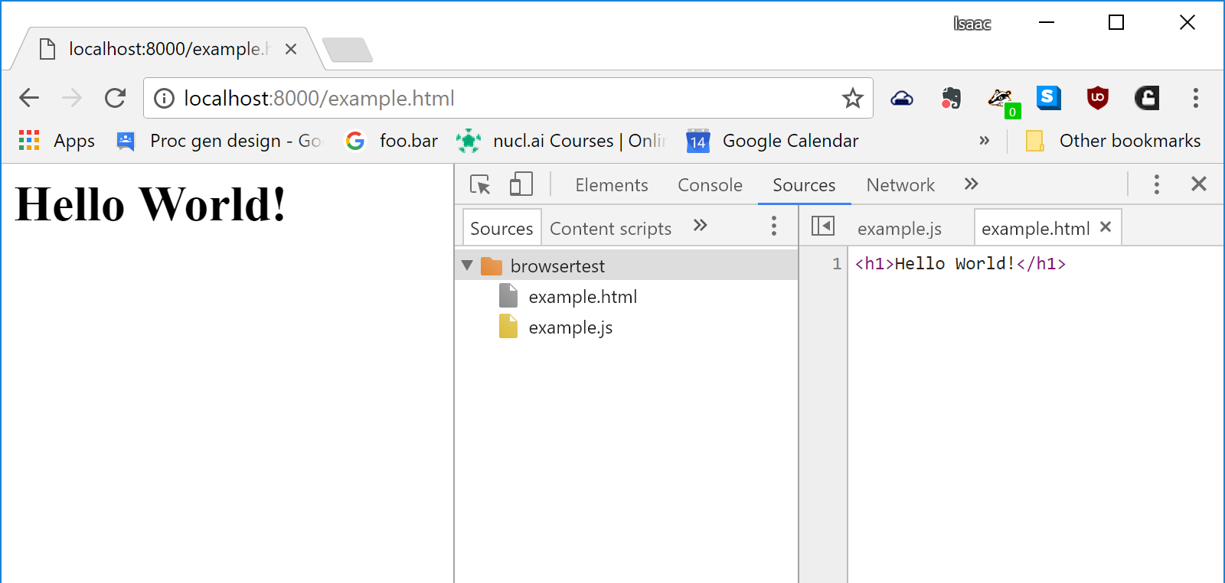
Edit html/js in the browser
Create empty .html and .js files in the same folder the server is running in.
Open your html file in the browser (make sure your path includes localhost, not file:///).
Open the developer tools (Chrome Menu > More Tools > Developer Tools) and go to the Sources tab.
Right click on the html file and “Add folder to workspace”. Select the folder containing your html file. Right click on the html file and establish mapping.
Write some HTML, save it, and refresh the page!

Slide 5
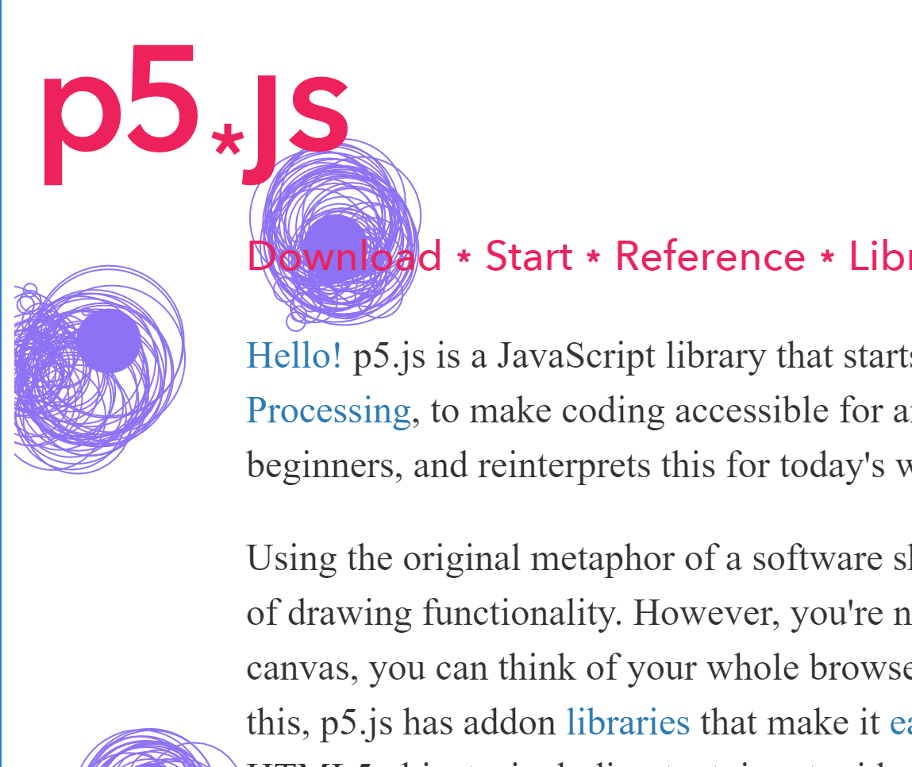
P5js
Guide to getting started with P5js
https://p5js.org/get-started/
Complete API reference
https://p5js.org/reference/
Code example that reads pixels from an existing image and draws using those colors:
https://p5js.org/examples/image-pointillism.html

Slide 6
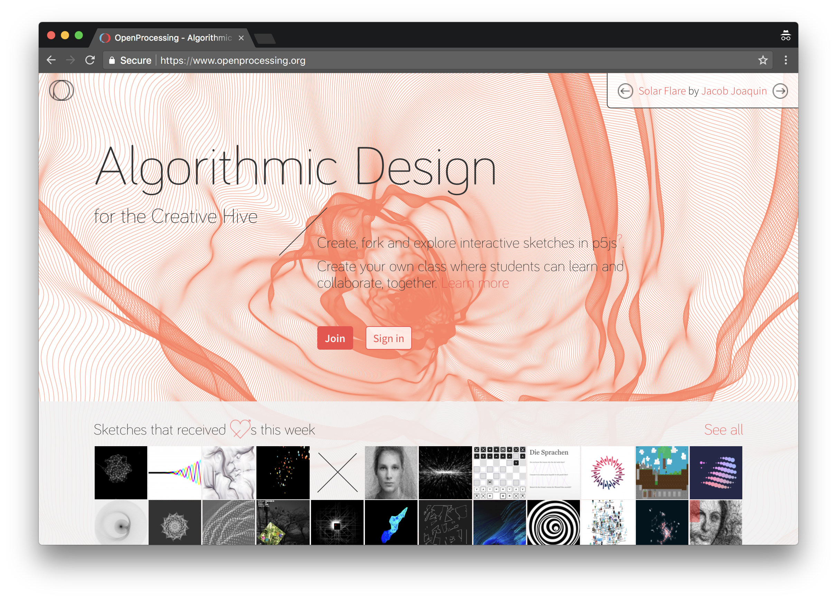
Use your creativity
We don’t require you to do specific things with the P5js API, but you should explore the alternatives to find something that looks good to you.
Find inspiration on OpenProcessing. Cite your sources with a comment in the Code if your program is inspired by a Specific sketch on this site.
https://www.openprocessing.org/

Slide 7
Submission on Canvas
Submit a .zip file containing your main html file and any other resources on which it depends (probably one .js file and one image file).

Slide 8
Grading Criteria
[1pt] Some html file with visible contents was submitted
[1pt] It runs without any errors in the JS console.
[1pt] Some colored shape was drawn using P5js library functions.
[1pt] Many colored shapes fill the canvas without user input.
[2pt] The display depends on an external image file.
[2pt] The page includes text describing your technique in natural language

